Slide 1
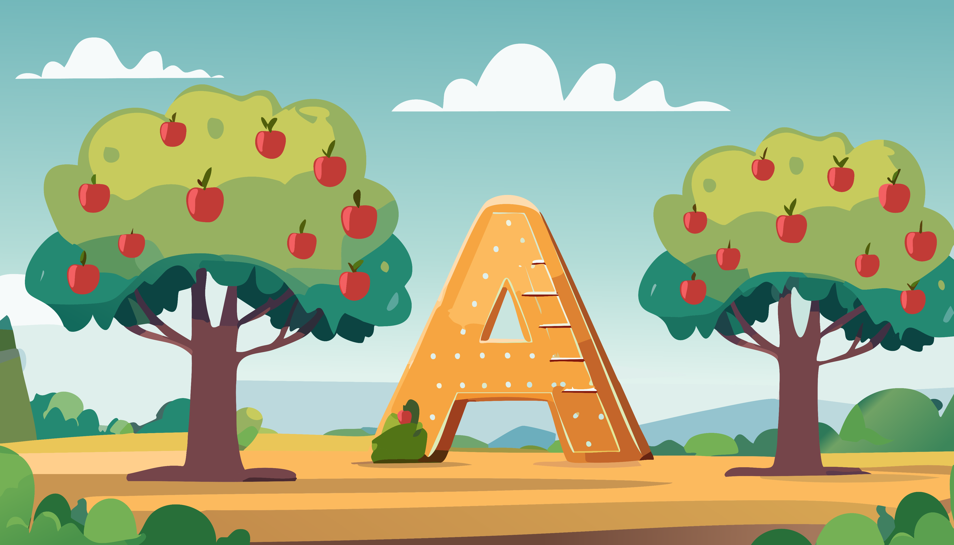

Level 0 - Lesson 1:
Sound /a/ (Letter A)
i
22–25 minutes
Notes:
Lesson Goal:
Students will be able to:
Recognize the letter A/a
Say the sound /a/ clearly
Associate the sound with the word apple

Slide 2


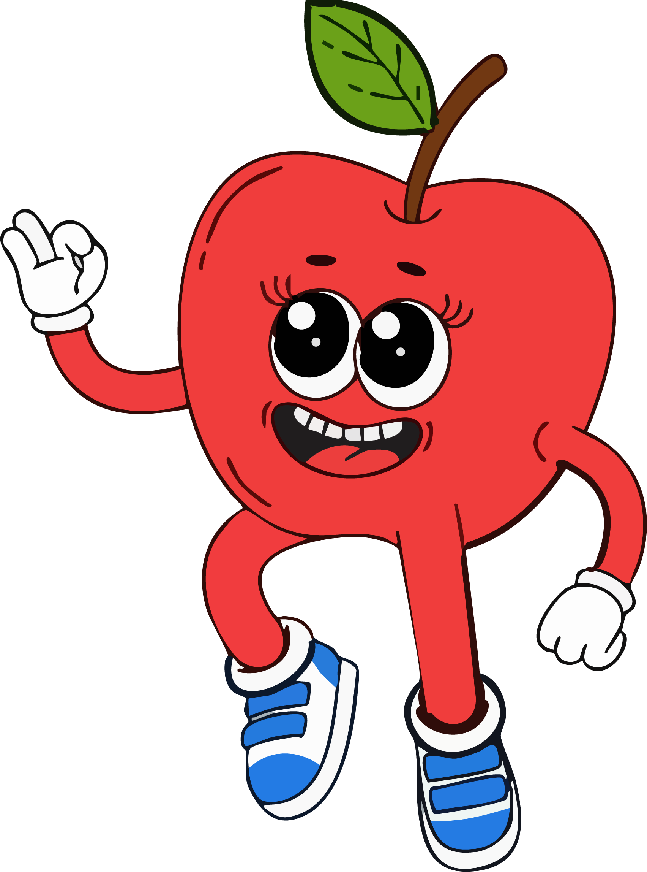
Hello, Hello,
Can you clap your hands?
Notes:
The speaker button is for playing the song “Hello, Hello, Clap your hands”

Slide 3
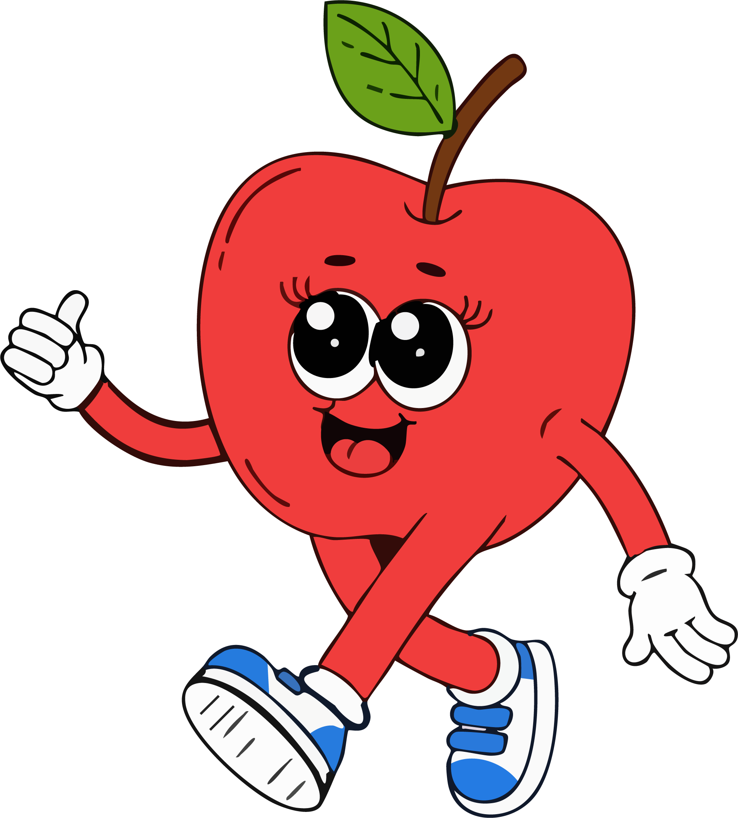
Hello Student
Notes:
Greet the students by name: “Hello, [Name]!”
Encourage them to wave or smile back.

Slide 4
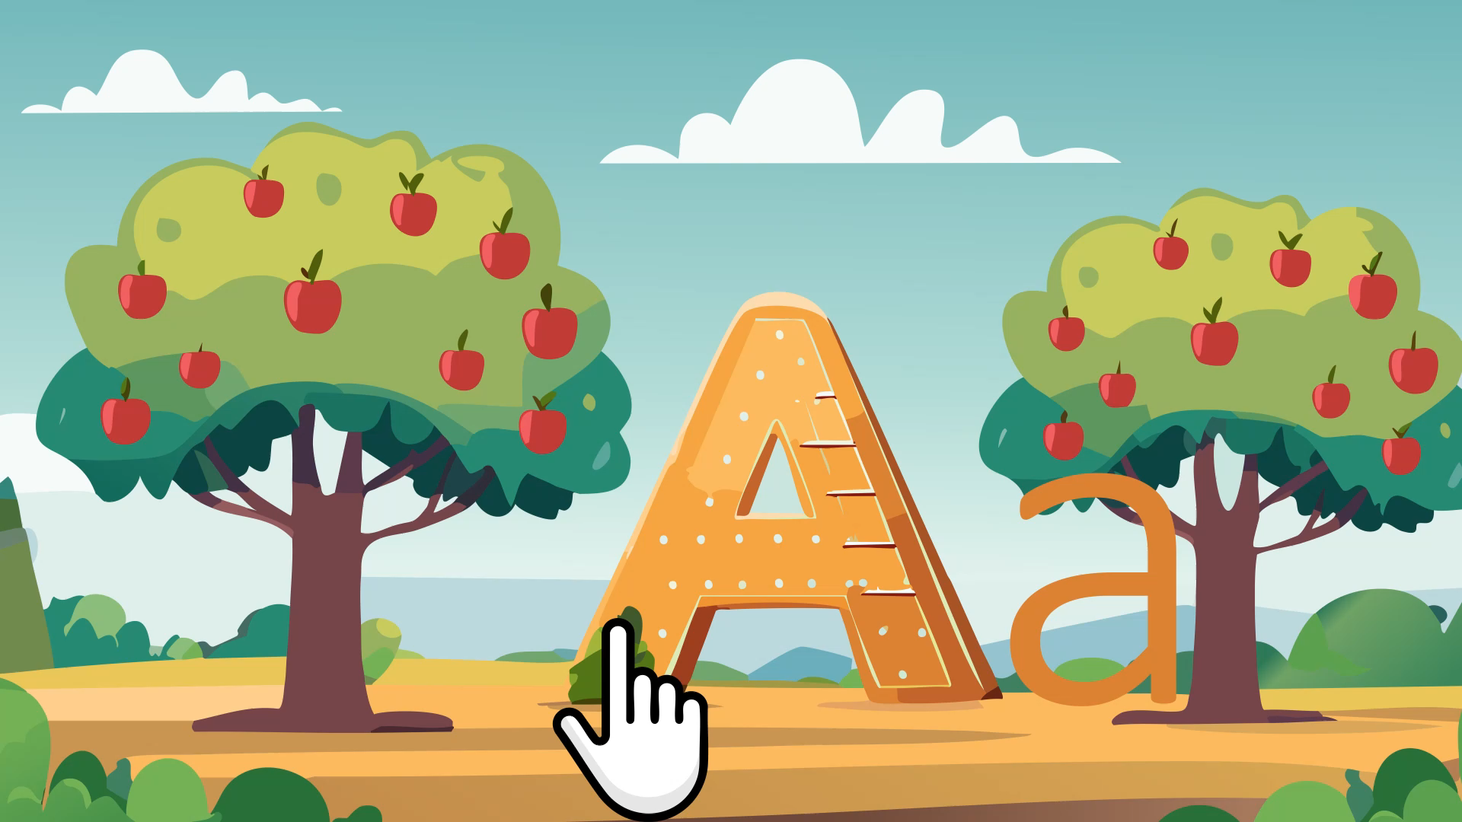
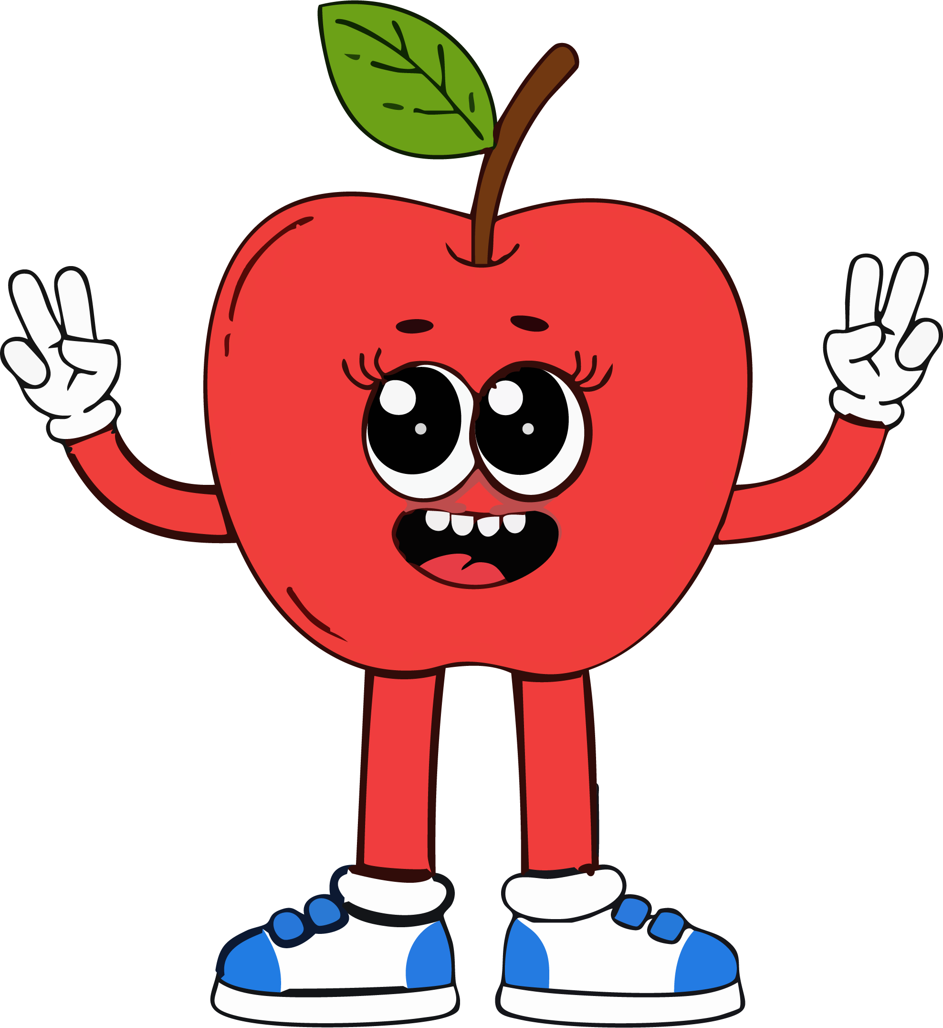
Let’s introduce the letter A /a/!
Notes:
- Say clearly:
This is the letter A. A says /a/.” (repeat 2–3 times)
- Press play for the finger to trace the A
- Have students repeat after you:
“A says /a/.”

Slide 5

“/a/, /a/, /a/ like apple”
Notes:
- Press on the speaker Icon for letter A sound
- Use your mouth close to the camera to model the sound clearly

Slide 6
Lets do it slowly and happily!
“Can you say /a/ ?
Notes:
Repeat slowly and encourage students to say it back

Slide 7
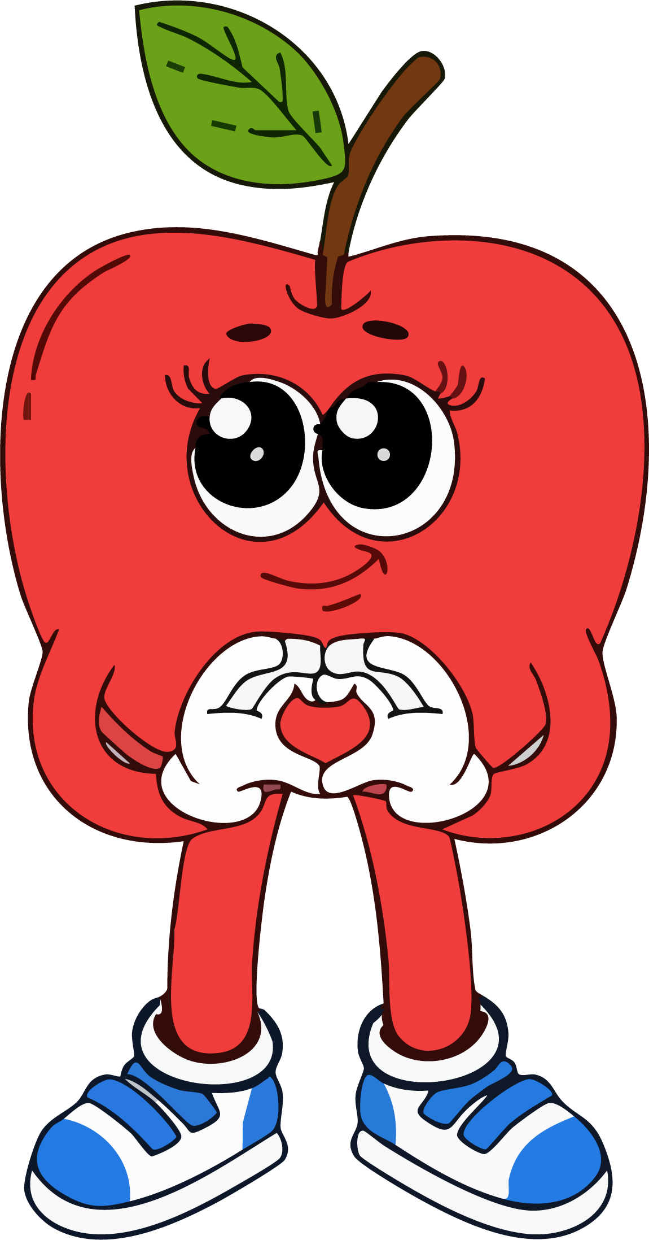
Great job!

Slide 8
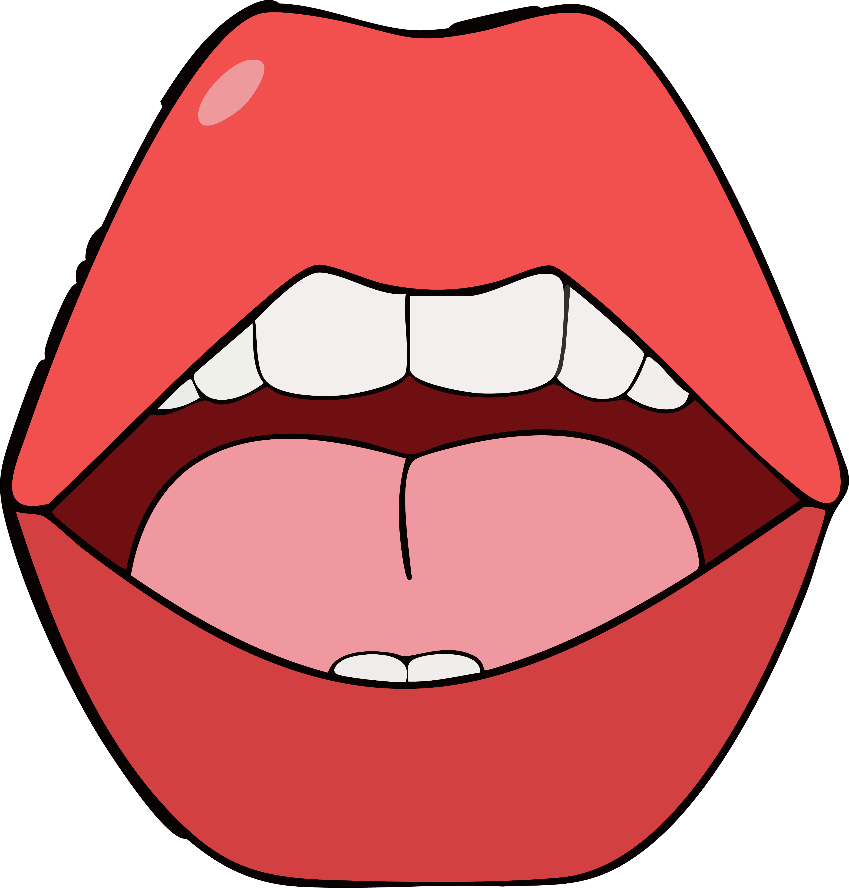
Let’s open our mouths like an apple! /a/, /a/!
Notes:
Activity 1

Slide 9


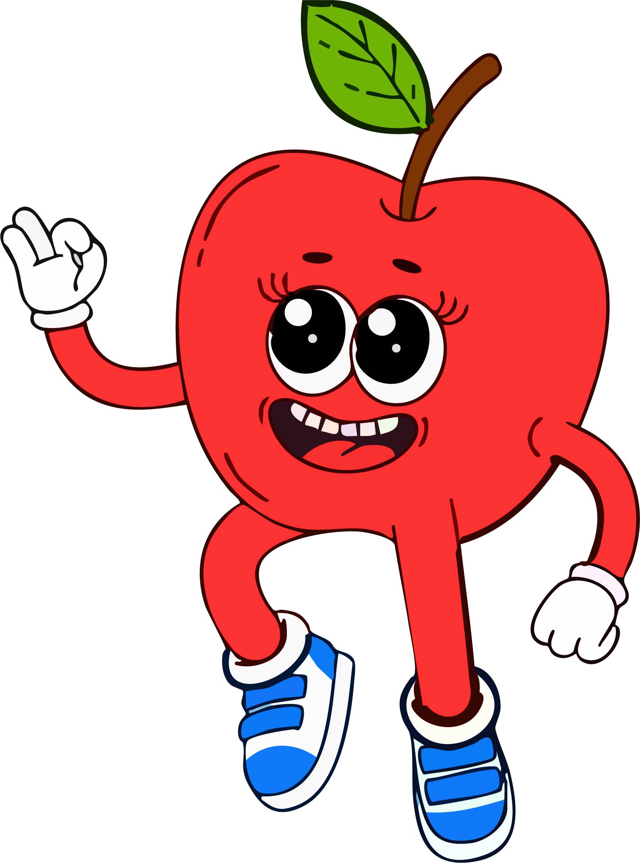

A says /a/. A is for apple. Apple starts with /a/!
What is this?
What sound?

Slide 10
Let’s practice!
Notes:
Interactive Practice

Slide 11

Game 1: What’s This Sound?
Which one starts with /a/?
Notes:
let students choose by pointing or saying the word.

Slide 12

Game 2: Listen & Clap
“Let’s listen... APPLE! Clap or no clap?”
Apple, banana, ant, ball, axe
Notes:
Students clap only when they hear /a/
Make it fun and dramatic: “Let’s listen... APPLE! Clap or no clap?”

Slide 13
Quick review:
What letter?
What sound?
A is for...?

Slide 14
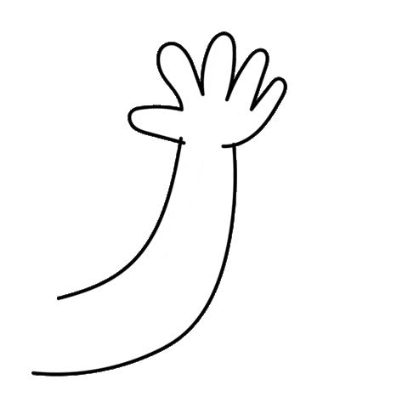
Goodbye! See you again!
Notes:
Wave and say goodbye to the student by name: “Goodbye, [Name]!”
Press the speaker to play the song

